Slide 1
Bing Webmaster Tools AI Performance Report
Microsoft has added AI Performance data to Bing Webmaster Tools
Insight is available on the specific Grounding Queries and URLs for which a brand is cited in AI Search
Opportunities to inform Generative Engine Optimisation can be obtained with analysis

Slide 2




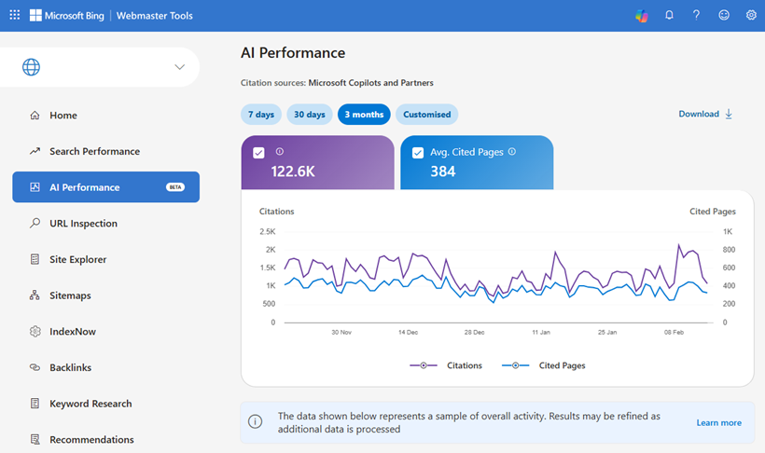
Bing Webmaster Tools AI Performance Report
WHAT HAPPENED
Microsoft has announced the beta rollout out of a new AI Performance report within Bing Webmaster Tools. For the first time brands can see how their owned content appears within AI-generated responses across Microsoft Copilot, Bing and partner AI experiences.
This provides unprecedented visibility into how AI models are selecting, grounding and citing content in real-world search experiences.
The move is the clearest signal to date that search performance shifting away from rankings and towards securing the citations which influence AI responses.
KEY TAKEAWAYS
We can now identify the specific Grounding Queries driving AI citations, and URLs used to inform responses at scale
AI visibility has become more measurable, comparable and optimisable
Significant variations exist in Grounding Queries and page performance versus traditional search with implications for optimisation
Grounding Queries data can be used to inform the on- and off-site content necessary to influence AI responses
KEY STRATEGIC OPPORTUNITIES
Understand how your brand is cited in AI responses over time
Identify the content necessary to influence AI responses
Prepare for Agentic Commerce throughout customer journeys
x

Slide 3
A valuable, actionable, source of AI Search insight
What data is available?
Two datasets are available which provide insight into how owned URLs are cited within AI-generated responses.
Grounding Queries – the queries for which your brand website has received citations.
Cited Pages - the specific URLs referenced and the frequency with which they are cited.
Whilst the data only shows grounding queries for which your own website is cited, it provides insights into the types of queries and intents AI is seeking to answer, informing the areas brands should aim to influence across owned and third-party websites.
If you are already set up in Google Search Console it is possible to access the reports in Bing Webmaster Tools without undergoing an additional verification process.
Publicis POV
Whilst it has long been possible to observe grounded queries for your own interactions in AI Search, the Microsoft AI Performance report provides the first official source of comprehensive grounding data from a major AI platform.
The data provides a tangible view of AI search behaviour enabling brands to operationalise Generative Engine Optimisation by identifying where they influence AI responses and informing future activation opportunities.
Grounding Queries represent validated AI demand. Citations represent brand influence.
Together these form a measurable framework for understanding how AI constructs answers, and how brands can influence responses.
With its focus on grounding queries and cited pages the report demonstrates that citations underpin a brand’s ability to influence a presence, perception and ultimately to monetise AI search. Brands must actively interpret this data to understand where they are shaping AI responses, and where they are absent, to prioritise optimisation efforts and strengthen their influence.
What’s next: Navigating AI Search developments with Publicis
Develop an activation plan for Generative Engine Optimisation
Engage with your Search Lead to:
Assess your website’s readiness for AI-driven discovery and commerce
Identify priority grounding queries and citation gaps
Align search, content and broader digital strategies around AI visibility
Develop and strengthen key content assets to improve citation presence
As AI search becomes embedded across discovery experiences brands that proactively measure, optimise and integrate AI visibility into a Connected Search strategy will secure a competitive advantage.
2. We Can Finally Measure AI Visibility
Until now, AI visibility was largely inferred.
With Bing’s report, we can:
Identify which queries trigger AI answers
See whether our content is being cited
Compare citation frequency over time
Spot competitors gaining AI visibility
This creates a new KPI layer:
AI Citation Share
Grounding Query Coverage
AI Impression-to-Citation Rate
In short: AI performance becomes measurable and optimisable.
What This Means for Our Clients
We are treating AI citation visibility as a core performance channel alongside organic rankings.
Our strategy now includes:
Monitoring AI grounding queries
Optimising content for citation eligibility
Strengthening entity relationships
Building “AI-referenceable” assets
Tracking competitor citation patterns
The brands that win will be those that:
Are structurally easy to understand
Demonstrate real expertise
Provide quotable, fact-rich content
Build authority beyond their own website

Slide 4








Grounding enables brands to influence AI Search
The role of Grounding in AI Search
When generating a response to a user prompt AI platforms frequently undertake a process known as grounding. This is the step where the model retrieves and anchors its answer in real-world verifiable sources, often webpages accessed through a live web search.
Grounding significantly reduces hallucinations and increases the factual accuracy of responses as well as ensuring answers reflect the latest published information.
From a Generative Engine Optimisation (GEO) perspective this is critical. If your content is selected during the grounding phase, it directly shapes the AI’s final response. This influences the brands that are surfaced and how they are perceived and presented to consumers. If your brand is absent from grounding sources you risk losing control of narrative or even becoming invisible in AI search experiences.
Grounding therefore represents the new battleground for visibility. Citations are the measurable output of this process and provide a clear signals of which sources the models trust and prioritise when constructing answers.
How the Grounding process works
best broadband for two people gaming simultaneously with good wifi coverage
1
User prompt
A user submits a natural-language prompt based on their specific circumstances
The user is probably looking for:
High download/upload speeds
Low latency
Price sensitivity
Location-specific availability
I know the user lives in Southampton
2
Intent deconstruction
AI model interprets true intent, breaking down the prompt into specific needs and contextual signals.
Lowest average ping broadband providers <southampton>
3
Query fanning
Prompt + interpreted intent used to construct a series grounding queries which will be searched to retrieve relevant resources.
Full fibre vs FTTC for gaming latency
Best UK ISP gaming performance reviews
4
Retrieval & Grounding
AI model evaluates retrieved sources and selects those it trusts to inform its response
Best overall for gaming & heavy use
Virgin Media – very fast (up to ~1 Gbps+), great for simultaneous gaming with solid Wi-Fi. MoneySuperMarket.com
BT / EE Full Fibre – fast, reliable with good coverage and low latency; EE includes strong Wi-Fi tech (Wi-Fi 7). CompareBroadband.co.uk
5
Response Generation + Citations
Answer generating using information from selected sources with citations signalling those shaping response.
← Citation

Slide 5
Query Grounding Insights
Analysis of Bing’s AI Performance report data across a selection of Performics clients shows:
Grounding Queries are longer than traditional searches
Grounding Queries have an average word count 77% greater than traditional search queries.
AI search behaviour skews heavily towards highly specific long tail prompts to reflect individual customer types, use cases, constraints and context.
What this means for brands:
Content strategies must move beyond head terms and category keywords and instead focus on:
Use-case driven content
Problem-solution pages
Content aligned to specific customer needs and contexts
AI Levels the Brand Playing Field
Across all analysed brands the proportion of branded Grounding Query citations is lower than the proportion of branded impressions in traditional search.
This gap is widest for ecommerce sites, where the vast majority of all citations were for non-branded Grounding Queries even where brands are heavily reliant on branded queries in traditional search.
What this means for brands:
AI search redistributes visibility towards websites with strong category expertise and in-depth informational content. Established brand demand is no longer enough to ensure you are surfaced. To be visible it is necessary to own broader conversations within your area.
Reputation Signals are Amplified
Queries containing “Review” generate between 1-10% of citations, indicating strong AI presence and influence at the evaluation stage of consumer journeys.
What this means for brands:
Reputation management becomes a vital part of optimising your presence within AI Search.
There is a need to actively manage reviews on third party websites as well as an opportunity to target ‘review’ focused keywords on your own website.
High-intent Commercial Modifiers Over-index
Phrases closely associated with transactions such as “discount code”, “best”, “compare” are over-represented in Grounding Query citations relative to traditional search.
What this means for brands:
As AI platforms develop their agentic commerce capabilities brands must ensure their own properties are the best available citations for high-intent queries to avoid leakage to affiliate partners.

Slide 6
Query Grounding Insights
AI is Influenced by Different Content Types
Editorial and About pages generate a significantly higher proportion of citations relative to their share of traditional search impressions. In contrast, homepages are cited far less frequently than they appear in standard search results.
On ecommerce sites individual product pages (PDPs) account for a much greater proportion of AI citations than search impressions.
What this means for brands:
AI systems favour explanatory content, trust signals and utilise detailed product information to help recommend suitable options to consumers.
Brands must invest in supporting content to answer all brand and category-lead questions.
Product pages should be fully populated with a specific focus on detailed attributes and how the product will be used.
Question-based Content Key for AI Citations
Queries containing “What”, “How”, “Where” or similar question phrasing account for a greater share of Grounding Query citations than they do of traditional search impressions.
This reflects the conversational nature of AI search where natural language questions are asked.
What this means for brands:
AI cites content that directly helps generate an answer, therefore brands must ensure they provide:
Editorial content with in-depth solutions to questions throughout the buying journey
FAQ content written in natural consumer language
Concise citable definitions of key industry concepts
What you can do now
Audit Citation Visibility to identify opportunities
Review the Grounding Queries driving AI citations to understand where your brand is, and isn’t, being surfaced across customer journeys.
Compare citation performance against traditional search impressions to identify at-risk areas for priority activation through targeted content optimisation.
Optimise for Citation Eligibility
Target high intent consideration-stage queries by enhancing product pages with detailed attributes and use-case based content.
Strengthen FAQ and solution lead editorial content to act as the authoritative, citable, source of answers in your space.
Reinforce Trust Signals
Expand reputational based content to influence review and comparison queries, implement an off-site reviews strategy.
Ensure “About” pages clearly demonstrate credibility and expertise.
Establish AI Performance Reporting
Monitoring Grounding Queries and cited pages over time and incorporate these metrics into Search reporting.

